Slide 1

Building a Modern App with Xamarin
Kevin Ford
Mobile Practice Lead
Magenic
Level: Intermediate

Slide 2
Development Options
Mobile Enabled Web
Hybrid
True
Native
Near Native
HTML5/JS
Cordova
Xamarin
Java-Android
Objective-C/ Swift /iOS

Slide 3




Application Architecture
HTML 5 UI
iOS UI
Windows Universal
Android UI
JavaScript BL
BL
BL
BL
Service Proxy
Data Portal
Data Portal
Data Portal
Reports
SQL Reporting
REST API
Data Portal
ASP.NET WA
BL
Excel
DAL
PowerPivot
SQL Database
Blobs
Notes:
Mostly concerned with orange layer
Share presentation, VM and M
VM and M also shared with UWP app
This is possible because we use an MVVM framework that allows us to span these different platforms

Slide 4
Layers Represent Decision Points
Interface
Interface Logic
Business Logic
Data Access
Data
Notes:
Layers give opportunity for code sharing
Closer to the interface and platform SDK you get, the less opportunity there is for sharing.

Slide 5
Technology Decision Factors
(S)peed/ Performance
(T)ime/Cost
(A)lways use Newest Features
(N)ative User Interface
(C)omplex Hardware / API interaction
(E)nterprise Services / Tools

Slide 6
Common Mobile Dev Platforms

Slide 7
Common Mobile Dev Platforms Pt 2

Slide 8
Xamarin’s Unique Approach
iOS C# UI
Android C# UI
Windows C# UI
Azure
Linux/Mono
CoreCLR
Shared C# Mobile
C# Server
Shared C# Client/Server
Shared C# codebase • 100% native API access • High performance
Notes:
With Xamarin it just isn’t your front end in C# it is your full backend server as well. With Azure or even on Linux running Mono or the CoreCLR your app is fully C# end to end!

Slide 9






Which Xamarin approach is best for your app?
Xamarin.Forms is best for:
Xamarin.iOS / Xamarin.Android is best for:
Data entry apps
Prototypes and proofs-of-concept
Apps that require little platform-specific functionality
Apps where code sharing is more important than custom UI
Apps that require specialized interaction
Apps with highly polished design
Apps that use many platform-specific APIs
Apps where custom UI is more important than code sharing
Learn more: xamarin.com/forms
Learn more: xamarin.com/platform
Notes:
Pick what is right for you!
Xamarin has this nifty guide to help you decide to go traditional or with Xamarin.Forms

Slide 10
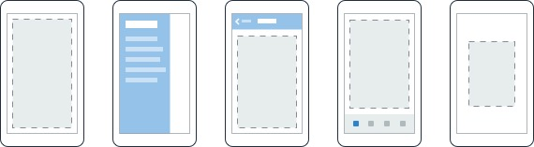
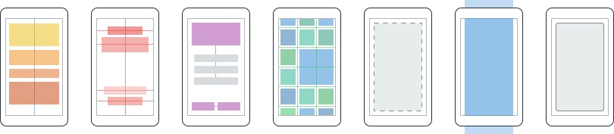
Layouts
Pages
Content
MasterDetail
Navigation
Tabbed
Carousel
Stack
Absolute
Relative
Grid
ContentView
ScrollView
Frame
Notes:
First you have a set of pages for each screen of your application
There are things like Content, and MasterDetail which gives you a nice flyout
With a tabbed view you get the correct look on each platform
iOS on bottom, Android on top, and on WP you have a Pivot control
Inside of a page are layouts
A lot of options from something simple like a stack panel to complex and powerful grids

Slide 11
Framework Capability Overlap
 | Xamarin Forms | MVVMCross | CSLA
Full UI coding
UI Binding
MVVM Structure
IoC Container / DI
UI /Component Abstractions (Navigation)
Global Messaging
Business/Validation/Authorization Logic
Server/Client Logic Sharing

Slide 12
MyVote MVVM Structure
View
Xamarin Forms – Layouts and data binding
ViewModel
MVVMCross – ViewModels and navigation
CSLA – Models and business logic
Model

Slide 13
Key MVVMCross Entities
MvxViewModel – Base class for all view models
MvxAppStart – Specifies what View Model for the application to use when starting
MvxApplication – Main cross platform application settings
Mvx – Mainly used for inversion of control
MvxCommand – Implements ICommand

Slide 14
ViewModel Lifecycle
Constructor([Dependency Injection parameters])
Init([Simple types or IMvxBundle])
Reload(SavedState state)
Start()

Slide 15
ViewModel Lifecycle
UserDialogServic
NetworkService
LoginService
LoginViewModel(IUserDialogService userDialogService, INetworkService networkService, ILoginService loginService)
Bundle Params
void InitFromBundle(IMvxBundle parameters)
Start()
SaveStateToBundle(IMvxBundle bundle)
ReloadFromBundle(IMvxBundle state)

Slide 16

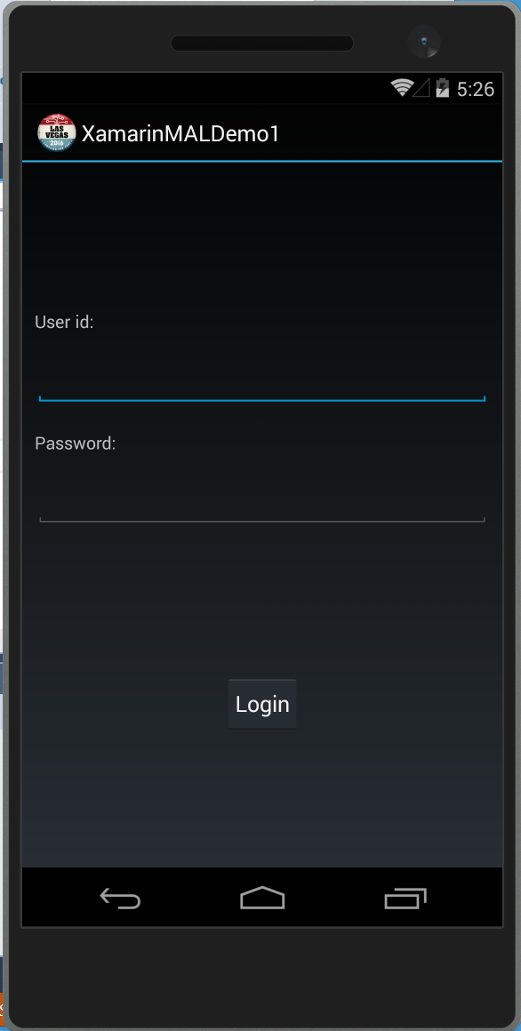
Starting An Android Application
SplashScreen : MvxSplashScreenActivity
Setup : MvxAndroidSetup
App : MvxApplication
LoginActivity : MvxActivity
LoginViewModel : MvxViewModel

Slide 17
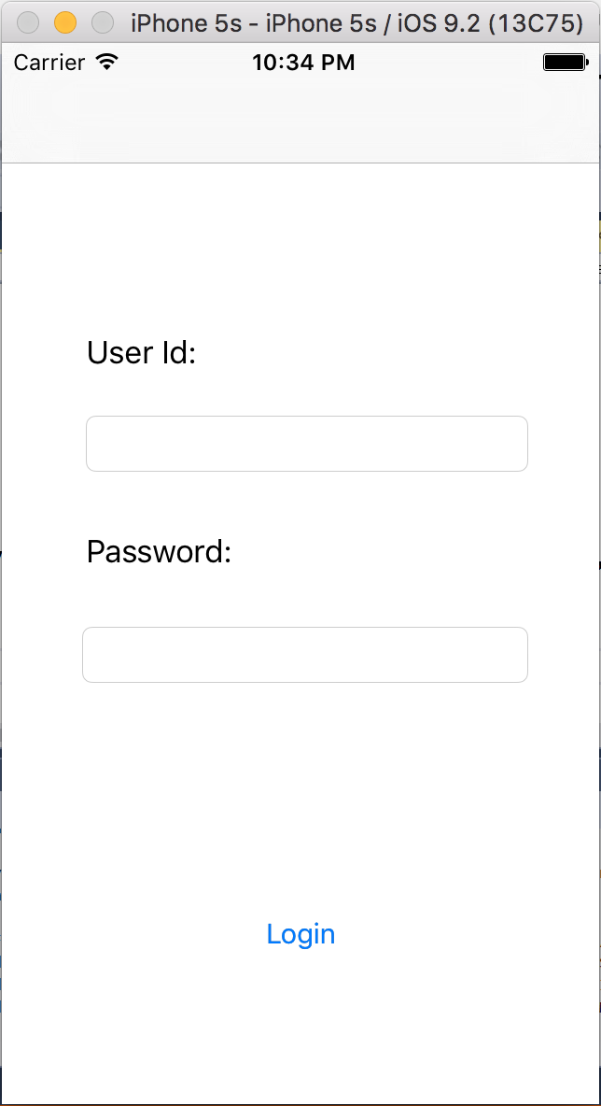

Starting An iOS Application
AppDelegate : MvxApplicationDelegate
Setup : MvxIosSetup
App : MvxApplication
LoginViewController : MvxViewController<LoginViewModel>
LoginViewModel : BaseViewModel

Slide 18
Starting the Application
public class App : MvxApplication
{
public App()
{
}
public override void Initialize()
{
RegisterAppStart<LoginViewModel>();
}
}

Slide 19
Loading from Storyboard
public class ViewsContainer : MvxIosViewsContainer
{
protected override IMvxIosView CreateViewOfType(Type viewType, MvxViewModelRequest request)
{
var storyboard = UIStoryboard.FromName("Main", null);
var returnValue = storyboard.InstantiateViewController(viewType.Name);
return (IMvxIosView)returnValue;
}
}

Slide 20
Demo – Setting up MVVMCross

Slide 21
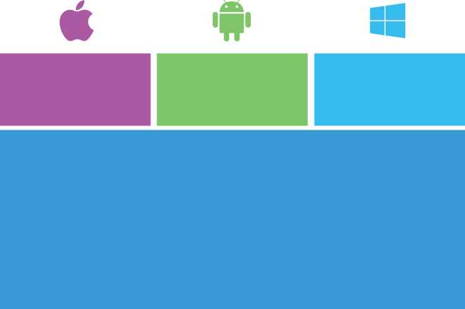
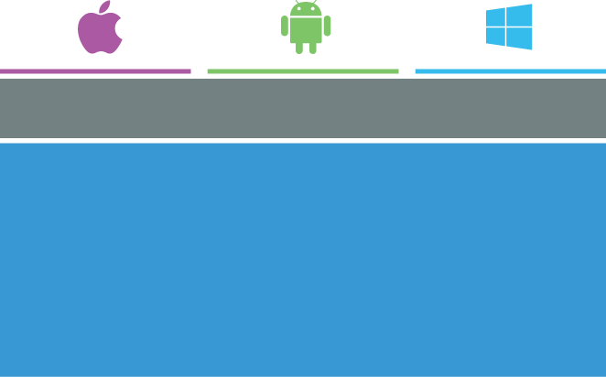

Moving from Xamarin Platform to Forms
iOS C# UI
Android C# UI
Windows C# UI
Xamarin.Forms
Shared App Logic
Shared App Logic
Xamarin.Android / Xamarin.iOS
Xamarin.Forms

Slide 22
Some Extra Things to Think About with Xamarin Forms
Items not Easily Controllable
ActionBar / SupportActionBar Coloring
Platform Specific Styling
Floating action buttons
Features that may only exist on one platform
ForceTouch
Amount of platform specific code

Slide 23
MVVMCross and Xamarin Forms
MVVMCross 4 offers special Library for Forms
Resolution of what page to load by convention
LoginViewModel tries to load LoginPage.xaml
Android has MvxFormsDroidPagePresenter
iOS uses MvxFormsIosPagePresenter
Expects app to use a NavigationPage
As always, can replace out default implementations

Slide 24
Key Entities
MvxFormsApp
MvxPresentationHint
FormsApplicationActivity
MvxFormsDroidPagePresenter
MvxFormsIosPagePresenter

Slide 25
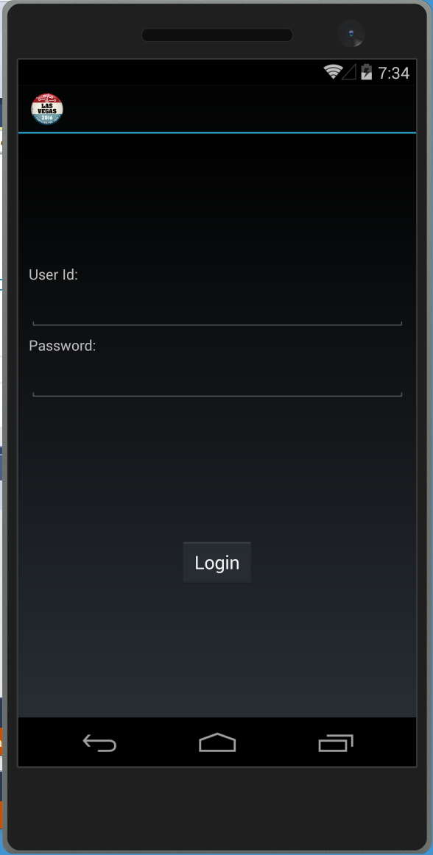
Starting An Android Forms Application
SplashScreen : MvxSplashScreenActivity
Setup : MvxAndroidSetup
App : MvxApplication
FormsActivity : FormsApplicationActivity
FormsApp : MvxFormsApp
LoginPage : ContentPage
LoginViewModel : MvxViewModel

Slide 26
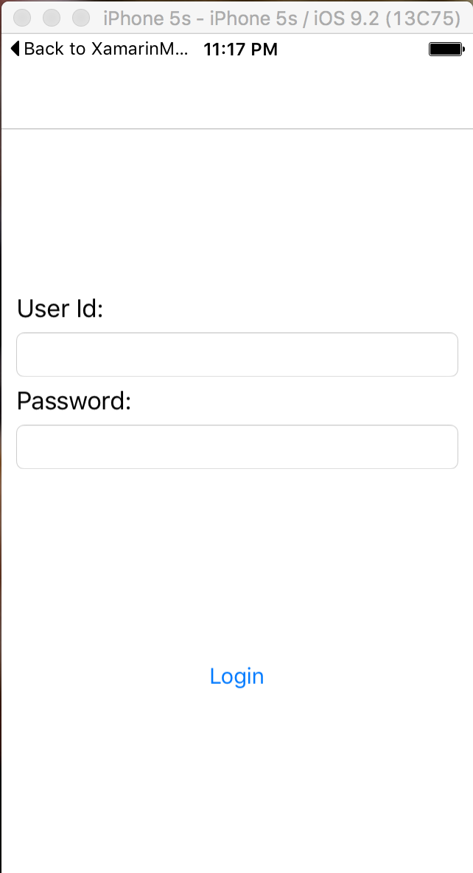
Starting An iOS Forms Application
AppDelegate : MvxApplicationDelegate
Setup : MvxIosSetup
App : MvxApplication
LoginPage : ContentPage
LoginViewModel : BaseViewModel

Slide 27
Xamarin Forms Binding
<Entry Text="{Binding Password, Mode=TwoWay, Converter=PasswordConverter, ConverterParameter=23, Path=PathToBinding, Source='DifferentSource', StringFormat='formatstring'}" IsPassword="True" Grid.Column="0" Grid.Row="4" HorizontalOptions="FillAndExpand" />

Slide 28
Creating a Value Converter
public class DateConverter : IValueConverter
{
public object Convert(object value, Type targetType, object parameter, CultureInfo culture)
{
var inputValue = value as DateTime?;
if (inputValue.HasValue)
{
return inputValue.Value.ToShortDateString();
}
return value;
}
public object ConvertBack(object value, Type targetType, object parameter, CultureInfo culture)
{
throw new NotImplementedException();
}
}

Slide 29
Demo – Using Forms with MVVMCross

Slide 30
Custom Renderers
View
iOS
Android
UWP

Slide 31
Demo – Creating a Custom Renderer

Slide 32
Links
Sample Code: https://github.com/Bowman74/VSLiveXamarinModernApps.git

Slide 33
Thank you!
Kevin Ford
Twitter: @Bowman74
kevinf@magenic.com
http://windingroadway.blogspot.com

